Slide 1
Cooking Connections: An Interdisciplinary Nutrition Education Recipe
for Children with Developmental Disabilities
Caiton Wilmoth, MA, RD/LD

Slide 2
Introduction
Born and raised in Lawton, Oklahoma
May 2023: Graduated from the University of Tulsa with a Bachelor’s of Science in Biochemistry
July 2025: Graduated from the Master’s of Arts in Dietetics Coordinated Program at the University of Oklahoma Health Sciences Center
August 2025: Began working as a clinical dietitian at the JD McCarty Center in Norman, OK
September 2025: Passed the RD exam!
Notes:
Before we jump in, I’d like to tell you a bit about myself and how I became a Registered Dietitian. I am an Oklahoma girl through and through. I was born and raised in Lawton, Oklahoma. I grew up always being interested in science, health, and medicine. I played pretty much every sport I could, and I have severe food allergies, so food and nutrition quickly became a big part of my life.
I went to college at the University of Tulsa and studied biochemistry on a pre-med track, and I got very interested in nutrition and metabolism. I knew I wanted to stay in the health field, but began questioning if the medical school route was right for me. In the spring of my junior year, I attended a healthcare career fair and learned about Registered Dietitians. It was like a light bulb went off. I quickly began researching what it would take to become an RD, and scheduled a meeting with my career advisor. She helped me change a few of my electives for the upcoming year to fulfil my degree and meet nutrition pre-req requirements. I began applying to graduate programs my senior year.
I attended OUHSC in their MA in Dietetics Coordinated Program, completing my didactic courses and supervised practice rotations at the VA Medical Center, Oklahoma Children’s Hospital, Harold Hamm Diabetes Center, a sports nutrition private practice, and the JD McCarty Center. I graduated in July 2025, began working as a clinical dietitian at the JD McCarty Center here in Norman in August 2025, and passed the RD exam in September 2025.

Slide 3
Learning Objectives
Describe the role of interdisciplinary collaboration between dietitians and therapists in supporting nutrition education for children with developmental disabilities.
Identify key benefits of cooking group interventions for children with developmental disabilities, including increased food acceptance, fine motor skill development, and self-efficacy in the kitchen.
Integrate visual recipes and other accessibility tools to support the participation of children with developmental disabilities in cooking sessions.
Notes:
I primarily work with children with developmental disabilities at a pediatric rehab hospital that offers inpatient and outpatient rehabilitation therapies, nutrition, and ABA services. In this presentation, I am going to tell you about the Cooking Group Therapy I am leading at my hospital alongside a recreational therapist and physical therapy assistant. I will also discuss the importance of RDs expanding nutrition and cooking education in this population. Learning objectives for today include:
-Describe the role of interdisciplinary collaboration between dietitians and therapists in supporting nutrition education for children with developmental disabilities.
-Identify key benefits of cooking group interventions for children with developmental disabilities, including increased food acceptance, fine motor skill development, and self-efficacy in the kitchen.
-Integrate visual recipes and other accessibility tools to support the participation of children with developmental disabilities in cooking sessions.

Slide 4
Developmental Disabilities
Developmental disabilities - “a group of conditions due to an impairment in physical, learning, language, or behavior areas”¹
1 in 6 children in the U.S. from ages 3 to 17 are affected by one or more developmental disabilities¹
Include ADHD, autism spectrum disorder, cerebral palsy, fragile x syndrome, hearing loss, intellectual disabilities, and others¹
Occur across all racial, ethnic, and socioeconomic groups¹
Notes:
First let’s discuss some background on this population. The CDC defines developmental disabilities as a group of conditions due to an impairment in physical, learning, language, or behavior areas. 1 in 6 children in the US ages 3 to 17, or about 17%, are affected by one or more developmental disabilities such as ADHD, autism, cerebral palsy, fragile X syndrome, hearing loss, intellectual disabilities, and more. These occur across all racial, ethnic, and socioeconomic groups in the U.S.

Slide 5
Childhood Obesity Rates and Diet Quality
19% of children and adolescents in the US have obesity²
In Oklahoma, 13.6% of 10-17 year olds are overweight, and 18.7% are obese²
Only 20.3% of Oklahoma high schoolers eat fruit or drink fruit juice 2 or more times per day²
9.4% of Oklahoma high schoolers eat vegetables 3 or more times per day²
20.5% of children in Oklahoma are food insecure²
Notes:
2021-2023 NHANES data indicated that 19.3% of children and adolescents aged 2 to 19 years in the US have obesity. In Oklahoma, 13.6% of 10-17 year olds are overweight, and 18.7% are obese. Additionally, diet quality among adolescents in our state is poor. Only 20.3% of Oklahoma high schoolers eat fruit or drink fruit juice 2 or more times per day, and 9.4% of Oklahoma high schools eat vegetables 3 or more times per day. Of course, it is worth noting that 20.5% of children in Oklahoma are food insecure, and only 23% of Oklahomans felt that there was a good selection of high quality fruits and vegetables available in their neighborhood. So of course, affordability and access to food is going to have a large impact on diet quality in our state.

Slide 6
Why Does It Matter?
Children and adolescents with obesity …
Are 5 times more likely to be obese in adulthood than non-obese children³
Are at risk of chronic health conditions like asthma, hypertension, diabetes, and chronic kidney disease⁴
May experience increased levels of teasing and bullying from peers due to weight-based stigmas⁵
Have higher rates of self-harm and suicide when bullied about their weight⁵
Notes:
As nutrition professionals, we know the importance of maintaining healthy lifestyles, but let’s talk about it. We know that BMI alone is not a good indicator of health, but there are some associations found amongst obese children. A systematic review and meta analysis of large cohort studies involving over 200,000 participants found that obese children and adolescents were around five times more likely to be obese in adulthood than those who were not obese (Simmonds et al). The CDC reports that obesity in childhood and adolescence is a risk of chronic health conditions like asthma, hypertension, diabetes, and chronic kidney disease (CDC consequences). A report published by the American Academy of Pediatrics showed that children with obesity experience higher levels of teasing and bullying by their peers due to weight-based stigmas. They also showed that self-harm behaviors and suicidality are higher among youth who have been teased or bullied about their weight compared with same-weight peers who have not been teased. (AAP - Stigma)

Slide 7
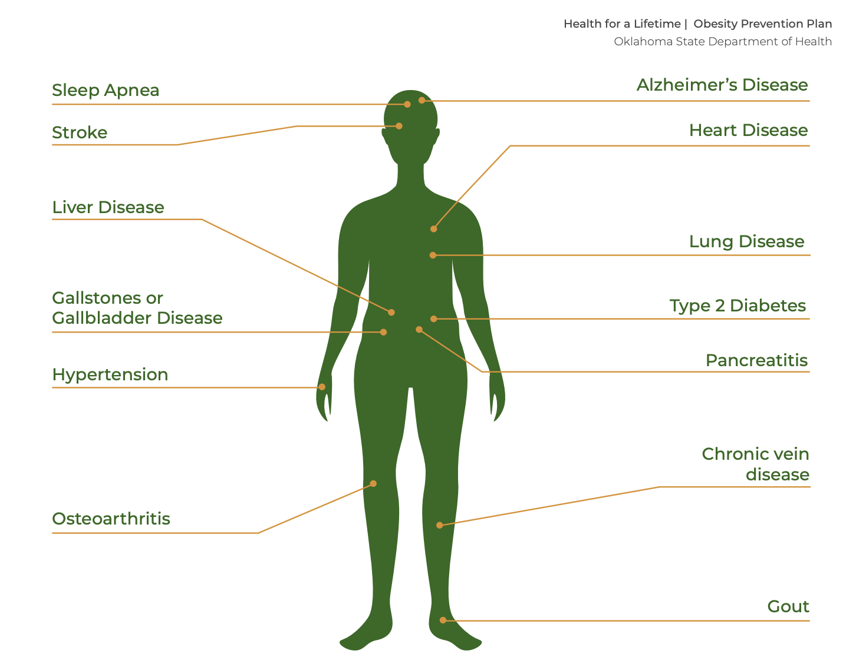
Graphic from State of Oklahoma Obesity Prevention Plan²
Notes:
This graphic from the State of Oklahoma’s Obesity Prevention Plan shows many of the potential health effects obesity can have on the body. We see pretty much every organ system affected, including the brain, heart, lungs, GI tract, and bones.

Slide 8
How Obesity Affects Children with IDD
Children with IDD are twice as likely to be obese compared to typically developing children⁶
Obesity has been associated with higher rates of ADHD, behavioral, and mental health problems⁶
Youth with IDD and obesity have higher rates of obesity-related secondary conditions like high blood pressure, high cholesterol, diabetes, and pressure sores⁷
Notes:
Let’s dive deeper into how obesity and its related chronic conditions affect individuals with intellectual and developmental disabilities.
Data from the 2011-2012 National Survey on Children’s Health indicated that children with IDD were twice as likely to be obese compared to typically developing children (Segal et al). This may be due to fewer opportunities for inclusive physical activity and poor gross motor skills, as well as low impulse control, leading to low tolerance for turn taking, following directions, and pushing oneself to physical limits or discomfort (Segal et al). Additional studies have found higher rates of other conditions associated with obesity, including attention deficit/hyperactivity disorder, behavior problems, anxiety, and depression (Segal et al). Obese youth with IDD have also been shown to have a higher number of obesity-related secondary conditions, including high blood pressure, high cholesterol, diabetes, and pressure sores (Rimmer et al).

Slide 9
Why Does This Happen?
Children with IDD…
Are more likely to live in poverty⁶
Have lower rates of physical activity than typically developing children⁶
Experience high rates of feeding difficulties - dysphagia, picky eating^{8,9}
May struggle with ADLs and IADLs¹⁰
Notes:
The National Survey on Children’s Health found children with ID were significantly more likely to live in poverty, which is a risk factor for obesity and many other health conditions due to lack of access to health care and affordable food options (Segal et al). The survey also showed children with IDD had lower rates of physical activity than their typically developing peers. (Segal et al). Additionally, many children with developmental disabilities experience some sort of feeding difficulties, including dysphagia, oral sensorimotor skills, or picky eating. Some sources estimate that as many as 80% of children with IDD have feeding difficulties. Sensory processing difficulties and delayed oral motor skills often lead to food selectivity and repetitive, restrictive eating behaviors in individuals with IDD, particularly those with autism. And of course, we often see that children with developmental disabilities struggle to meet developmental milestones and perform activities of daily living and instrumental activities of daily living, such as hygiene, dressing, managing money, and cooking.

Slide 10
Dietitians, What Can We Do?
Complex issues and a complex population
Remember - we are the food experts!
Address food selectivity and picky eating
Improve diet quality and nutrition status
Correct clinical deficiencies while working towards goals
Collaborate with other professions
Notes:
As dietitians, we may see these complex issues and ask, what can we do? I’m sure very few of us have much training or experience working with this population. However, a lot of our skills translate across the board. While we may not be familiar with all of the nuances of working with children with a variety of disabilities, we need to remember that we are food experts! We have the expertise to target things like food selectivity and diet quality. When we equip our patients or clients and their families with the right tools, they can use them to work towards increasing their child’s food acceptance and improved nutrition status. Of course, we know kids that are really picky eaters may be lacking key nutrients in their diets. It is not uncommon to see these picky eaters refuse to eat entire food groups, leading to deficiencies in iron, Vitamin D, and more. These deficiencies need to be addressed with appropriate supplementation while working towards goals. While we focus on nutrition, we need to remember to collaborate with other professionals such as speech language pathologists to help with oral sensitivities and diet advancements, and occupational therapists for ADLs and feeding therapy.

Slide 11
Cooking Up Success
Opportunity for hands on education
Cooking = evidence based experience
Increase food acceptance and cooking confidence of children
Improve dietary choices
Practice ADLs, fine motor skills, and working with others
Notes:
Whether we call ourselves a good cook or not, most dietitians have some basic culinary experience, even if it’s just from our food preparation classes and food service rotations. If we are going to be food experts, we can strive to provide some education for our patients or clients to prepare the foods we recommend to them. This becomes more challenging when we are working with children, especially kids that face challenges like picky eating and difficulty performing IADLs.
This presents an opportunity for dietitians and other professionals to collaborate and provide hands-on nutrition education and cooking experience. There are many studies showing that food preparation experiences and cooking curriculums can help increase cooking confidence, food preparation skills, and food acceptance in school aged children, which can in turn help improve dietary quality and overall health.

Slide 12
The Impact of Cooking and Tasting Curriculums
Cunningham-Sabo and Lohse studied the effects of a school based nutrition education program¹¹
11 public schools, 961 fourth grade students
5 2-hour cooking and tasting lessons vs 5 1-hour fruit and vegetable tasting lessons
Both lessons improved fruit and vegetable preferences, cooking self efficacy, and cooking attitudes
Notes:
Cunningham-Sabo L, Lohse B. Impact of a school-based cooking curriculum for fourth-grade students on attitudes and behaviors is influenced by gender and prior cooking experience. J Nutr Educ Behav. 2014;46(2):110-120. doi:10.1016/j.jneb.2013.09.007
One study compared the impacts of a school based nutrition education program consisting of either 5 2-hour cooking lessons or 5 1-hour fruit and vegetable tasting lessons throughout the school year. The study involved 11 low income public schools in Colorado. 961 fourth grade students participated. A pre- and post-survey was given to determine their cooking self-efficacy, cooking attitudes, and fruit and vegetable preferences. Researchers found that the both lessons positively affected fruit and vegetable preferences, especially in the cooking and tasting curriculum group. In both groups, children without prior cooking experience had significant gains in cooking self efficacy and cooking attitudes.

Slide 13
The Effects of School-Based Cooking Activities
Systematic review and meta-analysis of 21 studies¹²
Food preparation or cooking activities on school premises
Children ages 4-12
These activities had a positive effect on cooking self-efficacy, vegetable intake, and food literacy
Programs with more than 6 HOURS of cooking had greatest effects!
Notes:
Vaughan KL, Cade JE, Hetherington MM, Webster J, Evans CEL. The impact of school-based cooking classes on vegetable intake, cooking skills and food literacy of children aged 4-12 years: A systematic review of the evidence 2001-2021. Appetite. 2024;195:107238. doi:10.1016/j.appet.2024.107238
Another study looked at the outcomes of studies of children aged 4-12 years old receiving food preparation or cooking activities on school premises. A systematic review and meta analysis of 21 studies showed these activities had a small positive effect on cooking self-efficacy, vegetable intake, and food literacy. They found that programs with more than 6 hours of cooking showed the greatest effects. It’s definitely a marathon, not a sprint!

Slide 14
More Findings
Children are more likely to try a new food if they grow or cook it themselves¹³
Cooking interventions increase abilities to cut fruits and vegetables, follow recipes, and measure ingredients¹³
Youth with autism improved basic cooking skills, meal planning, and hand washing in a cooking program¹⁴
Young adults without IDD - higher levels of food preparation skills are associated with better diet quality¹⁵
Notes:
Hersch D, Perdue L, Ambroz T, Boucher JL. The impact of cooking classes on food-related preferences, attitudes, and behaviors of school-aged children: a systematic review of the evidence, 2003-2014. Prev Chronic Dis. 2014;11:E193. doi:10.5888/pcd11.140267
Wong MY, Carlton C, Paul S, et al. Cooking with confidence for autistic youth: outcomes from a pilot program evaluation model. BMC Res Notes. 2025;18(1):35. Published 2025 Jan 23. doi:10.1186/s13104-025-07105-6
Danon JC, Koon L, Sherman JR, et al. Feasibility and preliminary efficacy of a skill-based lifestyle intervention for enhancing cooking abilities and physical fitness in young adults with intellectual disabilities. Disabil Health J. 2025;18(2):101767. doi:10.1016/j.dhjo.2024.101767
Other studies have shown that children’s willingness to try new foods increased if they grew it or cooked it themselves. Some have reported increased abilities to cut up fruits and vegetables, follow recipes, and measure ingredients following cooking interventions. Remember- cooking requires a lot of reading, math, and fine motor skills. A cooking with confidence program for youth with autism found increased cooking confidence, meal planning abilities, the ability to use basic cooking techniques, and understanding when to wash their hands. Additionally, data from young adults without ID suggests that higher levels of food preparation skills are associated with reduced use of fast-food and an increased likelihood of meeting dietary objectives for fat, calcium, fruit and vegetable and whole-grain consumption.

Slide 15
Cooking Group Therapy
Led by Registered Dietitian, Recreational Therapist, and Physical Therapy Assistant
2-4 patients with developmental disabilities per group
1 hour per week
Nutrition education and cooking skills
Fine motor skills and IADLs
Behavioral goals
Notes:
All of this information supports the need for programs like the one I help lead at my facility. Each Thursday afternoon, I co-lead a Cooking Group Therapy along with a recreational therapist and a physical therapy assistant. We typically work with 2-4 patients for an hour (4 units of therapy). 2 of these kids attend outpatient ABA during the afternoons, so their registered behavior technicians accompany them to the group. This interdisciplinary approach helps target nutrition knowledge and cooking skills, as well fine motor skills, ADLs, behavioral goals.

Slide 16
Cooking Group Therapy Activities
Hand washing
Locating ingredients
Following recipes
Identifying appropriate measuring cups/spoons
Pouring, counting, and mixing ingredients
Practicing kitchen safety with appliances and knives
Notes:
Here are some of the main things we do in cooking group. We always start with hand washing. There have been many conversations about germs in cooking group, like washing your hands before you start cooking, after you sneeze, after you go to the bathroom. We’ve also had to talk a lot about why you can’t lick your fingers, or lick a spoon and stick it back into a shared bowl.
Of course, we practice reading labels and identifying ingredients. We have answered a lot of questions about these ingredients, like “where does flour come from?” or “what does baking soda do?.”
Next, we have to follow our recipes for the day. I always print out copies of the recipe for each child, and let them take them home so they can show their families and use it again. When we follow a recipe, we are practicing reading and math skills, and understanding sequences of tasks. Because there are usually 2-4 kids in the group, following the recipes also requires a lot of sharing and taking turns between tasks.
Following the recipe steps involves choosing correct measuring utensils, like wet or dry measuring cups, and identifying the right size measuring cup or spoon to use. This requires understanding fractions, or at least being able to match the numbers on the measuring cup with the one on the recipe. We have the kids compare ½ and ¼ cup and teaspoon vs tablespoon sizes.
Once the kids find the right measuring tool, they use fine motor skills to scoop or pour ingredients and add them to the mixture. Sometimes they need to count how many cups or teaspoons of something they have added. Then of course, the kids will mix ingredients, either by hand or with the hand-held mixer. The hand-held mixer is usually their favorite, and my worst nightmare… and we end up wiping cake batter off the walls. But if you aren’t making a mess, you aren’t cooking! Stirring or using the hand mixer requires bilateral coordination, like holding the bowl or pan steady with one hand while mixing with the other. This is another skill our PTA is great at teaching the kids. In just a few weeks, we have seen group members go from sloppy, unsteady mixing with one hand, to comfortably using both hands and mixing without prompting.
And then of course, we always remind the kids about safety needed to use the oven, the stove, and the blender or mixer. They usually have a good understanding of what is hot or sharp and should not be touched, but this sometimes results in overcautiousness and fear. Showing them ways to wave their hand above the stove or checking that the mixer is unplugged before touching the attached whisks helps them understand using the kitchen tools safely. Our OT department also has a stash of plastic “kid safe” chefs knives, which do a pretty good job of cutting food but not skin. We have practiced using these knives to cut fruits and vegetables on cutting boards, and we remind the kids not to touch the “blades” or point them at themselves or someone else.

Slide 17
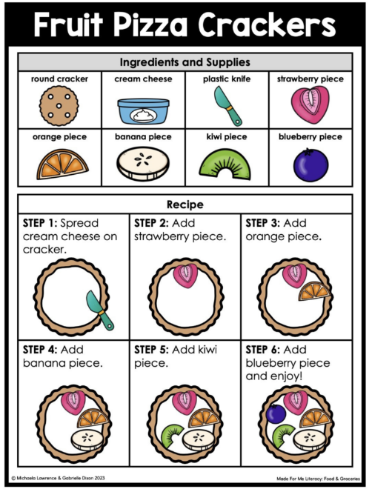
Visual Recipes
Similar to visual schedules
Break recipes into tangible steps
Help identify ingredients
Give examples of appliances and tools
Appropriate for lower levels of literacy and children with IDD
Image from “Especially Education”¹⁶
Notes:
Children with IDD often use visual aids like picture boards and visual schedules to understand sequence of events. This can include a broad schedule of their day, like breakfast, school, snack, therapy, lunch, etc., or they can be more detailed, like the steps of a recipe. Visual recipes are a great way to help kids with IDD identify ingredients and follow steps of a recipe in order. They can also help them match tools in the kitchen to example images of tools needed for the recipe. I use a free website called Accessible Chef to build most of our visual recipes for cooking group, but there are tons of options available online and in cookbooks.
Image from “Especially Education” https://especiallyeducation.com/visual-recipes-what-they-are-how-to-use-them/

Slide 18
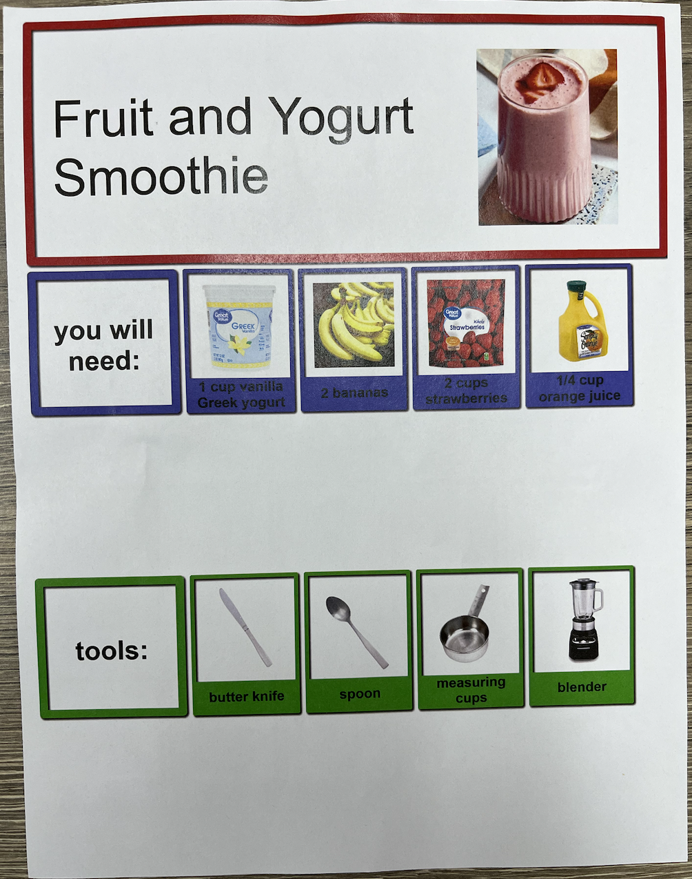
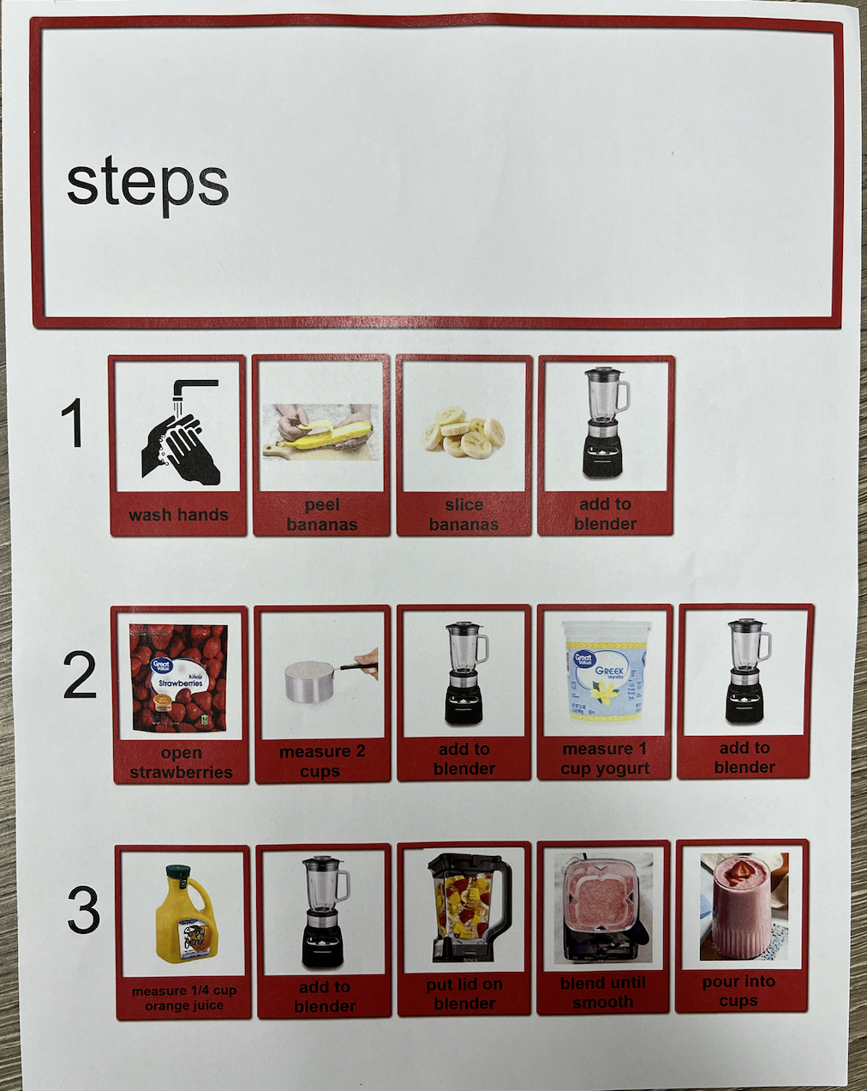
Notes:
Example: fruit and yogurt smoothie recipe
The kids in group loved making this one. You can see our visual recipe sheets show pictures of ingredients and tools needed on the first page, and then the steps to prepare them. Making this recipe required measuring the yogurt, berries, and juice. They also had to peel and slice bananas, practicing some knife skills (with a butter knife). And then of course, we talked about blender safety. Some of the kids really liked the blender and pushing the buttons, but a few did not care for the noise and got a little overwhelmed. So that noise sensitivity is definitely something to consider with this population.

Slide 19
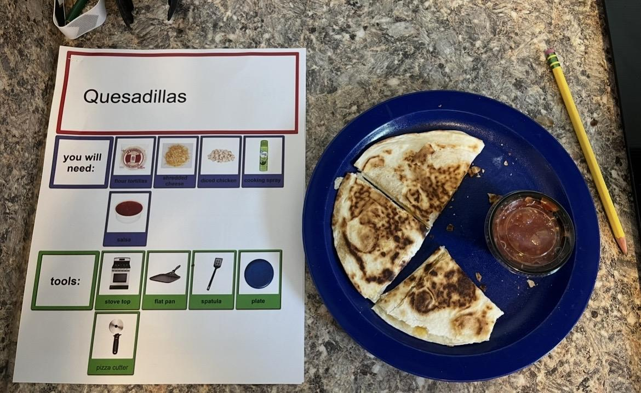
Notes:
Example: Quesadillas
This picture shows part of our quesadilla recipe, and one of the quesadillas the kids made. This was a great one because it is customizable. You can cook and add meat or veggies, or just use cheese. We’ve made them a few different ways with different kids in the group. We’ve also had salsa and guacamole to dip them in. The kids loved this one, and they really enjoyed flipping the quesadillas. That was great bilateral coordination and motor skill practice for them as well. And of course, we can talk about safety awareness and using the stovetop.

Slide 20
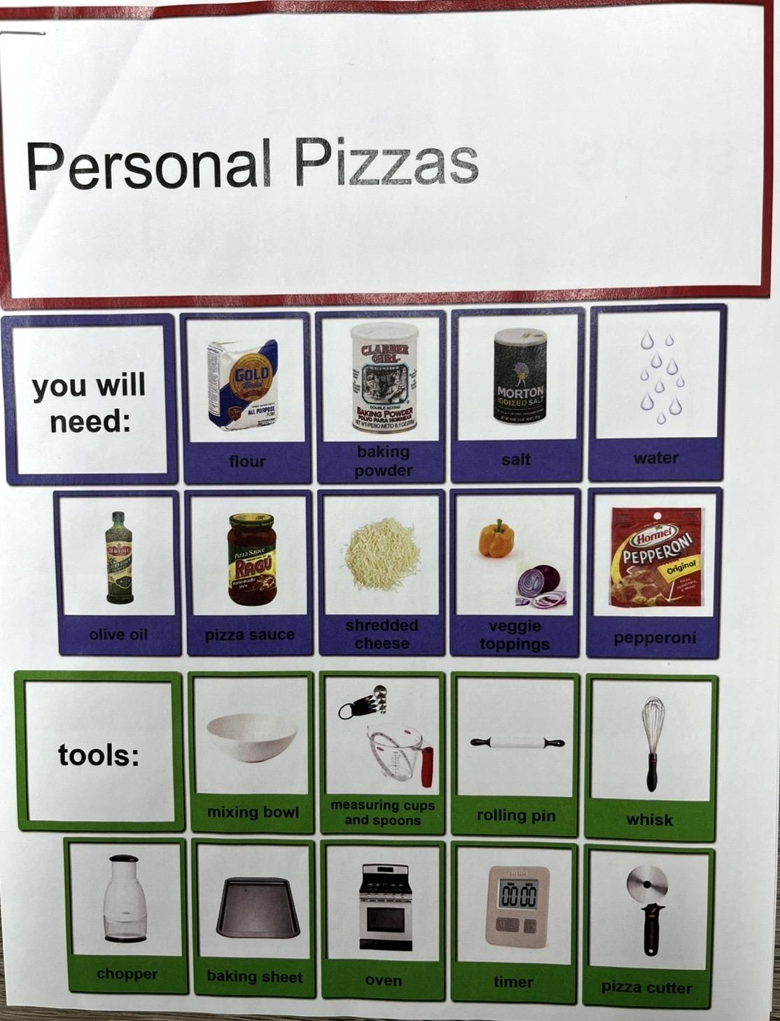
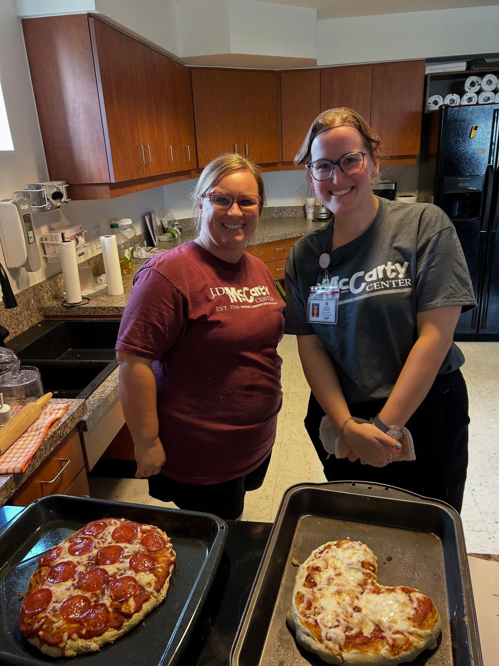
Notes:
Example: Personal Pizzas
Personal pizzas were a big hit. The kids got to knead and roll out their own dough and customize their toppings. One this day, I had a funny learning experience. I brought an onion and a bell pepper for the kids to chop and put on their pizzas, but of course, they all just wanted cheese or pepperoni. One of the kids in the group was crying thinking he had to put onion on his pizza, and he has autism, he’s a very picky eater. I assured him that he did not have to eat any onion if he didn’t want to. He did come around to the idea of peeling and cutting the onion, which he had never done before. He was so excited and proud of himself for that, and I was too! He still didn’t want to eat any of it, but it was a good reminder for me that just tolerating being around non-preferred foods, and even interacting with them through touch and smell, is a big step for a lot of these kids that have very strong food preferences.
And you can see Jennifer and I with some of the pizzas. She is a recreational therapist, and she helps lead the group every week.

Slide 21
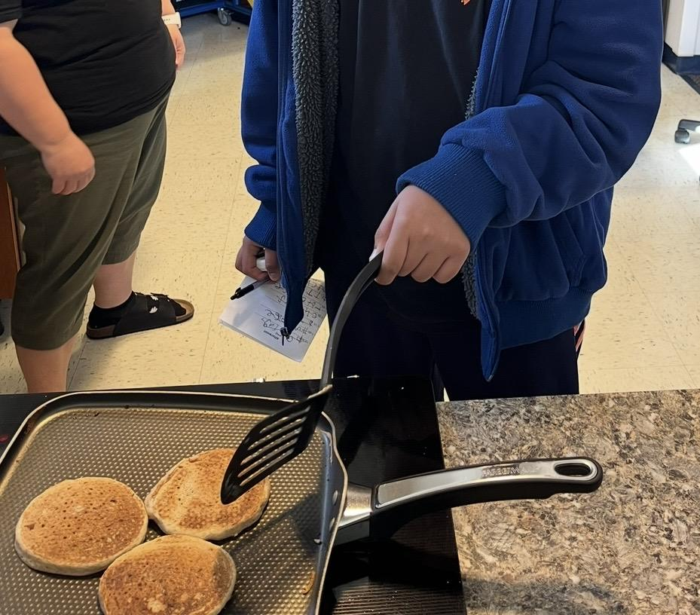
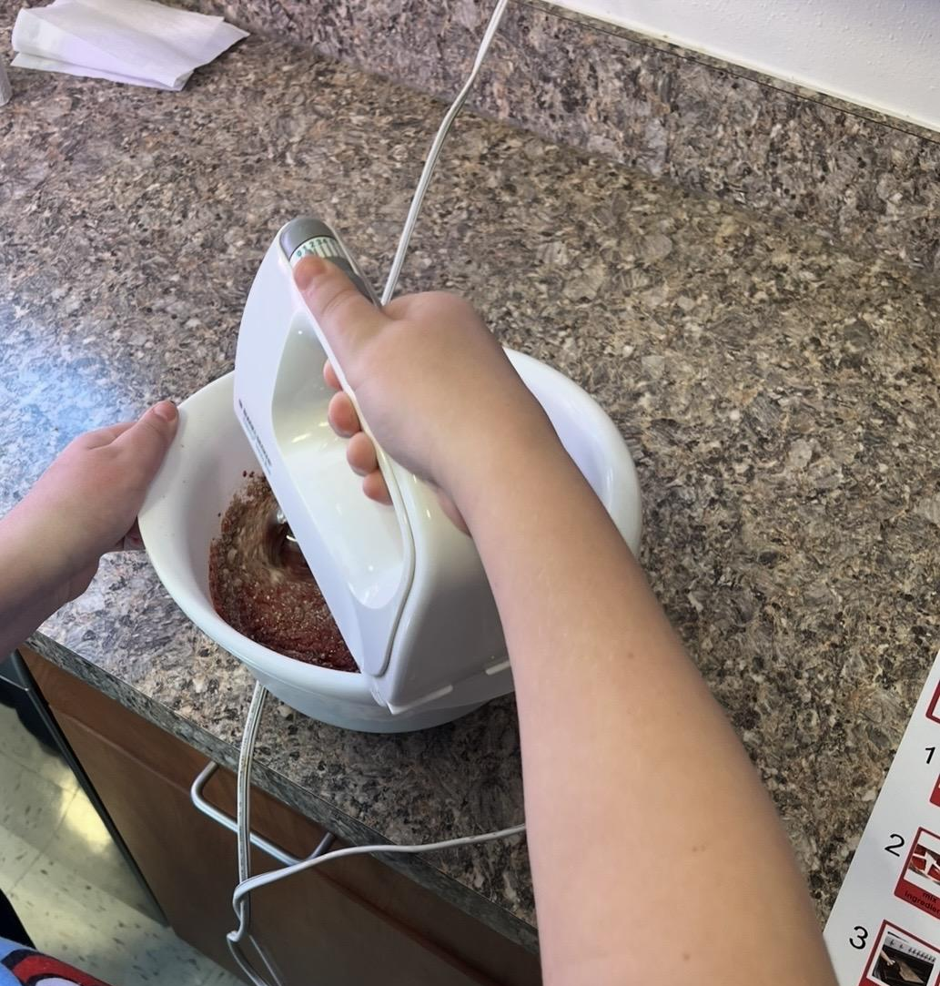
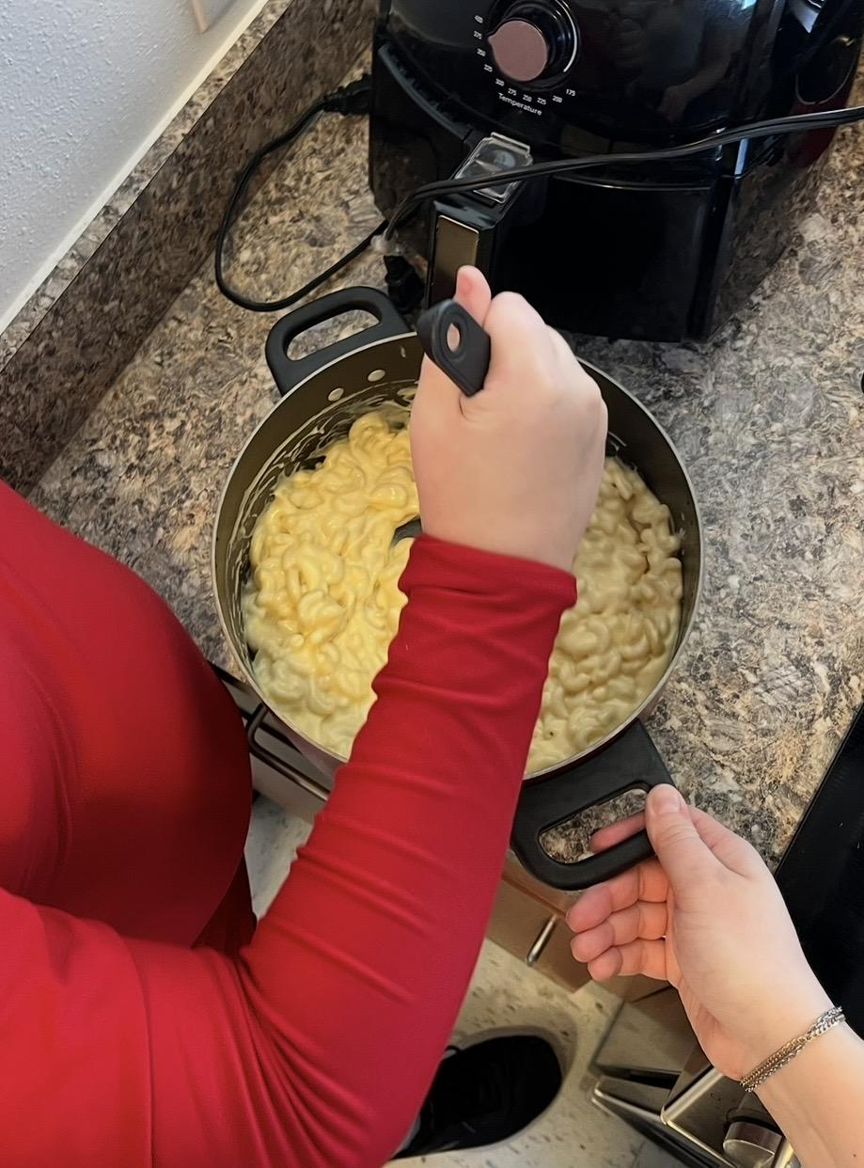
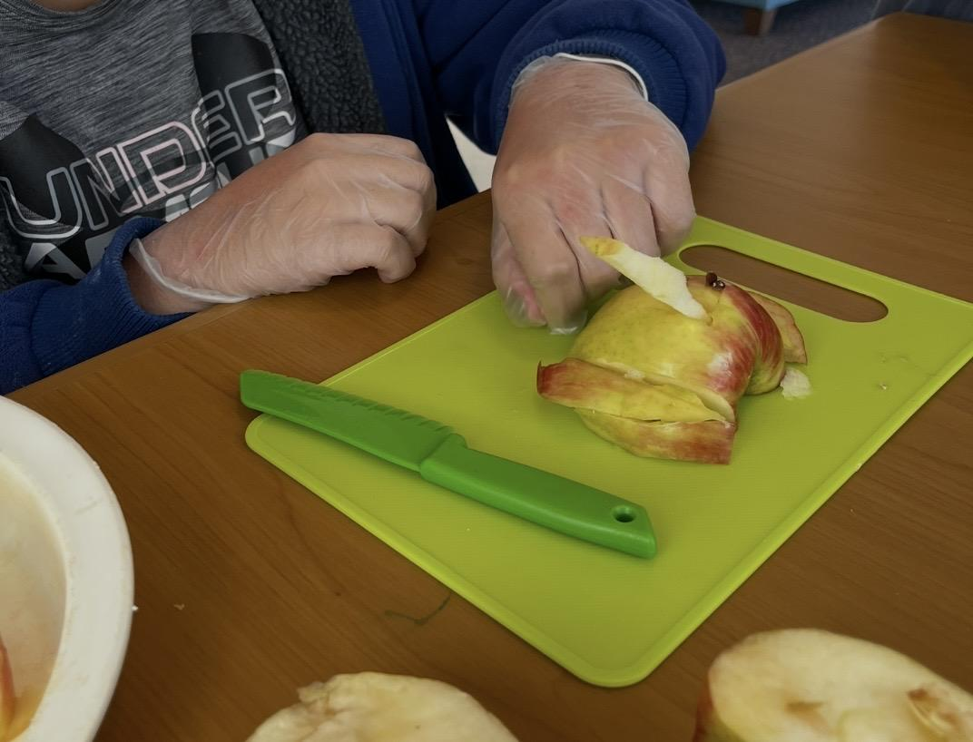
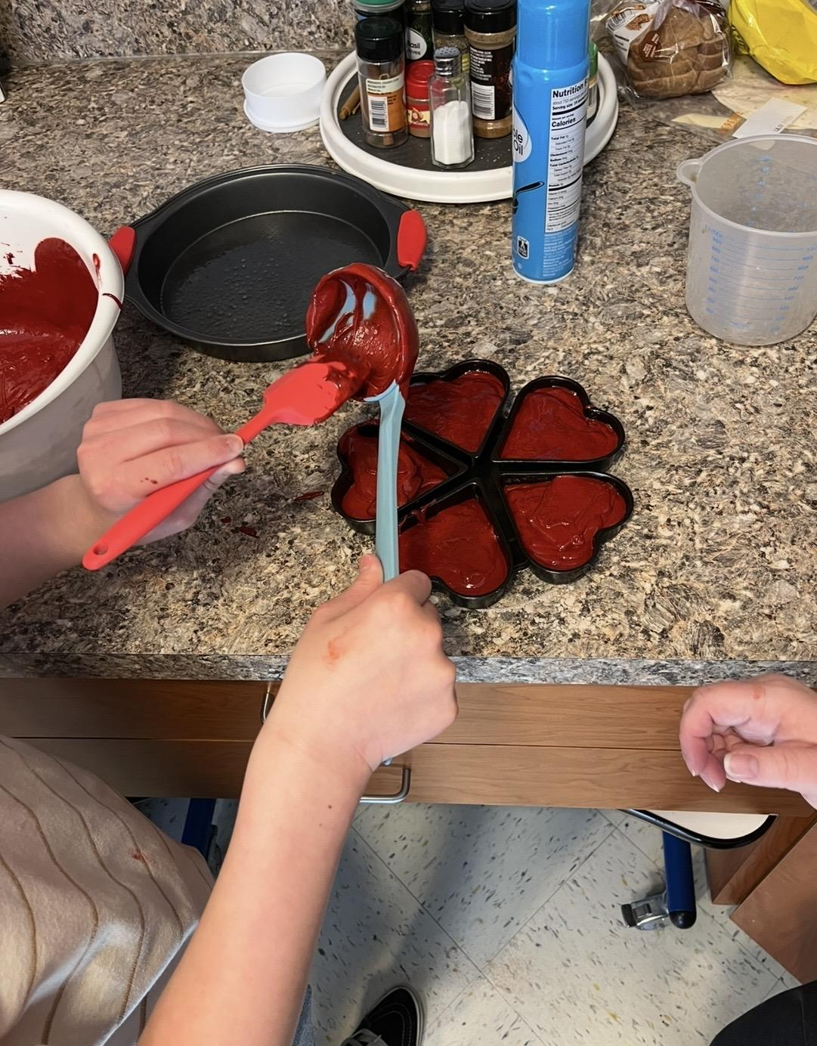
Notes:
Bonus photos:
Using the stove and flipping cinnamon applesauce pancakes (top left)
Using kid-safe knives to “carve” and build swans out of an apple (bottom left)
Making cupcakes - using the hand mixer - great skills safely holding the bowl with one hand and the mixer with the other (top middle)
Scooping batter into pans while making red velvet mini heart cakes for Valentine’s Day (bottom middle)
Making macaroni and cheese - stirring in homemade cheese sauce (right)

Slide 22
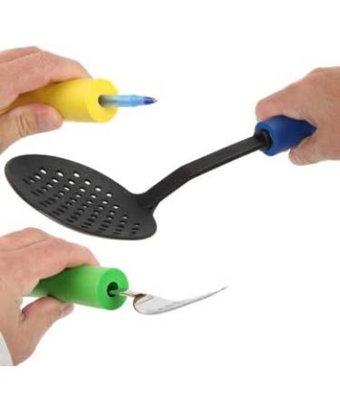
Additional Tools
Timers for EVERYTHING
Weighted utensils and foam tubing available
Lower table-top for wheelchair users
Coloring and fun fact sheets from MyPlate
Extra games or toys for breaks and continuing therapy goals
Picture from Global Supplies, gosupps.com
Notes:
One thing I cannot recommend enough when working with children, with or without IDD, is using timers. Just like with visual schedules, timers can be really helpful for providing predictability and structure for our therapy session, and they help with managing long wait times and transitions in the kitchen. We use them to time each child’s turn when they are using the mixer, so they know when to pass it to the next person. It also helps while we are waiting for our baked goods to finish in the oven, as the kids can regularly check and see how much longer until everything is ready. They also help guide our kids through non-preferred tasks and working for breaks.
Another tool we have available is weighted utensils, like built up, curved spoons and forks for feeding. These are stocked in our rehab kitchen by our occupational therapists. Not every kid needs these, but we have them on hand just in case. We also have foam tubing that we can add to our cooking tools to make them easier to grip. (see example photo) - picture from Global Supplies, gosupps.com
We also have a table and a pull-out low countertop that can be used for accessibility. This is great for our smaller kids, and our kids in wheelchairs that may not be able to vertically reach or get close enough to the regular kitchen countertops. Some of our kids have adjustable electric wheelchairs that can be raised up to counter height, but having these other options available is nice, and makes the group more accessible to this population.
Another tool I like to use is coloring sheets, especially if I can find one that matches the food we are making or has some fun facts about that food on it. I’ve been able to find a lot of cute, free coloring sheets online. MyPlate and ONIE have great coloring sheets and fun fact sheets for a variety of fruits and vegetables on their websites. These help occupy the kids while their food is still baking or cooling off, and it gives them something they can take home to remember the lesson.
And lastly, our rehab department is stocked with great games and toys. We use these when the kids are getting overwhelmed or tired and need to take a short break. We’ve also played board games like bingo and candyland while waiting for things to bake. Not only does this keep the kids occupied while they wait, but it also continues to work on skills like matching, counting, and communication that fit into their other therapy goals.

Slide 23
Key Takeaways
Children with developmental disabilities often have poor diet quality and face increased risks for obesity and chronic diseases
Nutrition and cooking education can help improve food acceptance and cooking confidence
Cooking lessons incorporate reading, math, social skills, fine motor skills
Collaborate with other professions to provide accessible, effective, and fun cooking experiences for kids with IDD
Notes:
I want to leave everyone with these key takeaways.
Number 1, consider that children with developmental disabilities often have poor diet quality and face increased risks for obesity and chronic diseases. This is a really complex issue that involves picky eating, sensory issues, dysphagia, physical limitations, and socioeconomic barriers to healthcare.
Number 2 , Know that providing nutrition education and cooking experiences can help improve food acceptance and cooking confidence for both typically developing children and children with intellectual or developmental disabilities
Number 3, Understand that cooking lessons incorporate reading, math, social skills, and fine motor skills. Cooking is a great opportunity for kids to practice these skills, at home or in a more formal therapy setting.
And number 4, Dietitians have a great opportunity to collaborate with other allied health professionals to provide accessible, effective, and fun cooking experiences for kids with IDD

Slide 24
References:
1. CDC. Developmental Disability Basics. Child Development. June 2, 2025. Accessed January 19, 2026. https://www.cdc.gov/child-development/about/developmental-disability-basics.html
2. State of Oklahoma- State Obesity Prevention Plan. Published online June 2022. https://oklahoma.gov/content/dam/ok/en/health/health2/documents/State%20of%20Oklahoma%20-%20State%20Obesity%20Prevention.pdf
3. Simmonds M, Llewellyn A, Owen CG, Woolacott N. Predicting adult obesity from childhood obesity: a systematic review and meta-analysis. Obes Rev. 2016;17(2):95-107. doi:10.1111/obr.12334
4. CDC. Causes and Consequences of Childhood Obesity. Centers for Disease Control and Prevention. July 15, 2022. Accessed June 12, 2024. https://www.cdc.gov/obesity/basics/consequences.html
5. Pont SJ, Puhl R, Cook SR, Slusser W, SECTION ON OBESITY, THE OBESITY SOCIETY. Stigma Experienced by Children and Adolescents With Obesity. Pediatrics. 2017;140(6):e20173034. doi:10.1542/peds.2017-3034
6. Segal M, Eliasziw M, Phillips S, et al. Intellectual disability is associated with increased risk for obesity in a nationally representative sample of U.S. children. Disabil Health J. 2016;9(3):392-398. doi:10.1016/j.dhjo.2015.12.003
7. Rimmer JH, Yamaki K, Lowry BMD, Wang E, Vogel LC. Obesity and obesity-related secondary conditions in adolescents with intellectual/developmental disabilities. Journal of Intellectual Disability Research. 2010;54(9):787-794. doi:10.1111/j.1365-2788.2010.01305.x
8. Gal E, Hardal-Nasser R, Engel-Yeger B. The relationship between the severity of eating problems and intellectual developmental deficit level. Research in Developmental Disabilities. 2011;32(5):1464-1469. doi:10.1016/j.ridd.2010.12.003
9. Breda C, Santero S, Conti MV, Cena H. Programmes to manage food selectivity in individuals with autism spectrum disorder. Nutrition Research Reviews. 2025;38(1):112-125. doi:10.1017/S0954422424000052
10. Paengkumhag C, Limpornchitwilai W, Supaluk S, Chamnongthai K, Kaewkamnerdpong B. Enhancing ADL skill acquisition in children with ASD through a personalized, fuzzy logic-based tablet game: a pilot study. Sci Rep. 2025;15(1):37691. doi:10.1038/s41598-025-21586-2
11. Cunningham-Sabo L, Lohse B. Impact of a school-based cooking curriculum for fourth-grade students on attitudes and behaviors is influenced by gender and prior cooking experience. J Nutr Educ Behav. 2014;46(2):110-120. doi:10.1016/j.jneb.2013.09.007
12. Vaughan KL, Cade JE, Hetherington MM, Webster J, Evans CEL. The impact of school-based cooking classes on vegetable intake, cooking skills and food literacy of children aged 4-12 years: A systematic review of the evidence 2001-2021. Appetite. 2024;195:107238. doi:10.1016/j.appet.2024.107238
13. Hersch D, Perdue L, Ambroz T, Boucher JL. The impact of cooking classes on food-related preferences, attitudes, and behaviors of school-aged children: a systematic review of the evidence, 2003-2014. Prev Chronic Dis. 2014;11:E193. doi:10.5888/pcd11.140267
14. Wong MY, Carlton C, Paul S, et al. Cooking with confidence for autistic youth: outcomes from a pilot program evaluation model. BMC Res Notes. 2025;18:35. doi:10.1186/s13104-025-07105-6
15. Danon JC, Koon L, Sherman JR, et al. Feasibility and preliminary efficacy of a skill-based lifestyle intervention for enhancing cooking abilities and physical fitness in young adults with intellectual disabilities. Disabil Health J. 2025;18(2):101767. doi:10.1016/j.dhjo.2024.101767
16. What are Visual Recipes and How to Use Them. Accessed March 2, 2026. https://especiallyeducation.com/visual-recipes-what-they-are-how-to-use-them/

Slide 25
Questions?

